Slide 1

Final Project Computer Vision
Alejandro Albert Gramaje

Slide 2

Introduction
This project aims at Exercise 5, which consist of developing a system capable of analyzing traffic cone images with the following goals:
Measure Width / Height ratio
Check if cones are correctly aligned
Detect damaged or broken cones

Slide 3
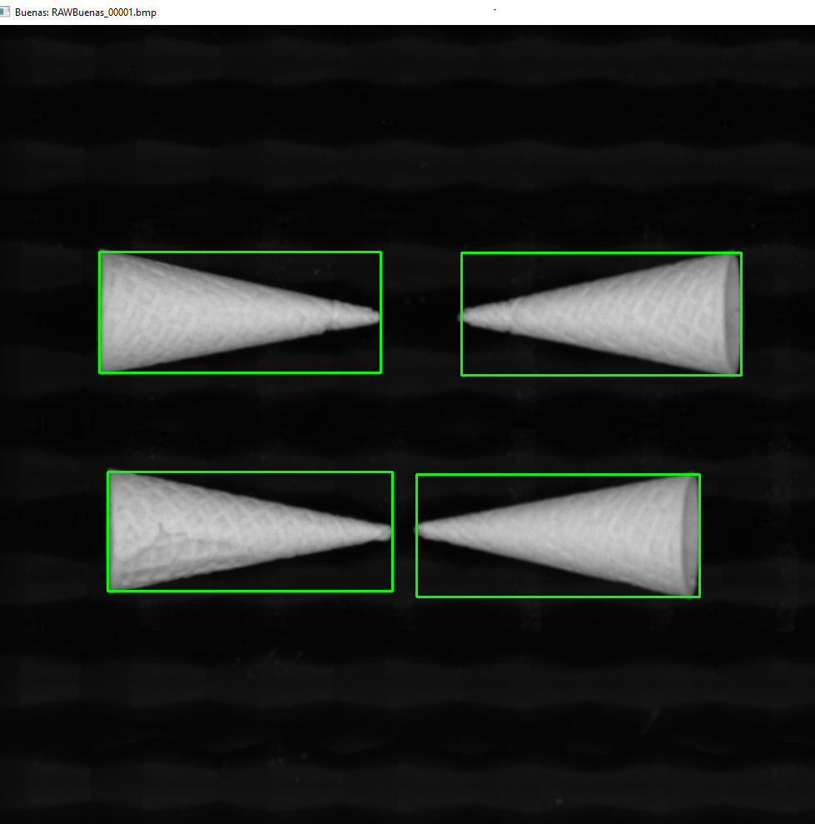
First Part
Each cone is validated against the expected dimensions:
Width between 300px and 345px
Height between 125px and 150px
Classified as valid or invalid accordingly
A green or red rectangle is used to show validation result

Slide 4
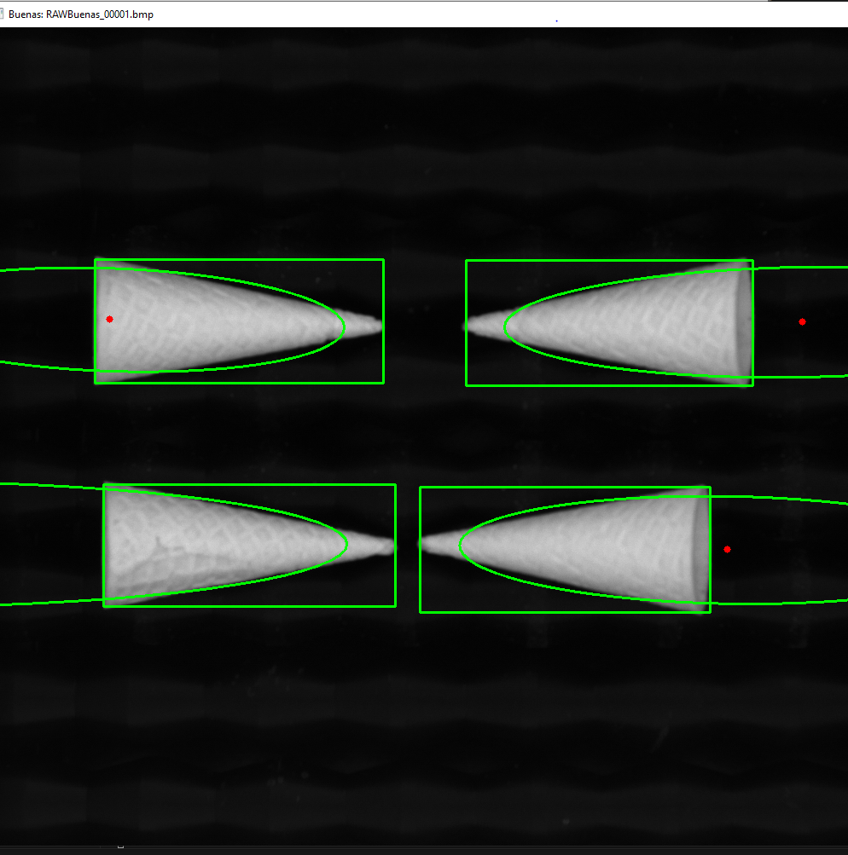
Second Part
The rotation angle is extracted
The cone is considered aligned if:
The angle is between 80° and 100°
The angle is between 265° and 285°
The ellipse and its center are visualized

Slide 5

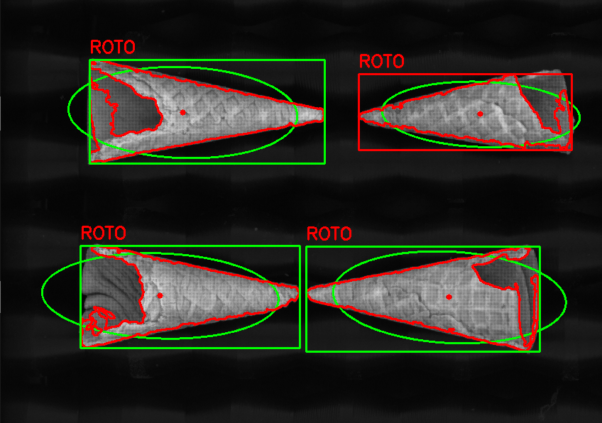
Third Part
Multiple templates from the folder with the good cones is taken
The current contour is compared against each template using shape similarity metrics.
If best similarity > 0.08, the cone is considered broken

Slide 6
Challenges Encountered
Finding the right threshold for binarization across all images
The creacion of Ellipses some times fails and it doesn’t créate properly
Building a reliable system to distinguish broken cones without false positives

Slide 7
Possible Improvements
Add more level of feedback for the user
Improve the algorithim that detectces broken cones
Automatically sort classified images into folders.

